Slide 1






SAST
Medical
PRESENTATION
Diagnostic
Centre
Management
Transforming Healthcare, Innovations and Challenges in Modern Days

Slide 2






SAST
Medical
Introduction
Sadman Hafij
Fatema Tuj Johura Sohi
Md. Adib Yasir
Nilima Chowdhury
232-15-119
232-15-133
232-15-697
232-15-801

Slide 3


SAST
Medical
TABLE OF CONTENTS
Sl. No. | TOPICS
1 | Objective
2 | Motivation
3 | Our Vision
4 | Our Mission
5 | Our Services
6 | System Architecture
7 | Code Breakdown
8 | Expected Outcomes
9 | Team Collaboration
10 | Future Directions
11 | Conclusion

Slide 4

SAST
Medical
Objective
Our diagnostic management program revolutionizes healthcare diagnostics by prioritizing efficiency and patient satisfaction. We minimize waiting times and provide vital service information, alongside personalized guidance, empowering patients at every step. Our goal is to set a new standard in diagnostic care, emphasizing convenience and excellence.

Slide 5

SAST
Medical
Motivation
All of us have experienced certain inconveniences at heath care centres. Wheather its waiting in long lines for reception, facing difficulties trying to match our schedule with our appointments, or trying to find legitimate information on services the centre provides.
And these things can get very annoying and problematic for patients wanting to receive fast and efficient treatment. We wish to help such patients so that no sick person has to go through any unnecessary inconveniences.

Slide 6



SAST
Medical
Our Vision
Streamlined appointment processing for reduced waiting times and improved efficiency.
Enhanced patient experience through easy access to necessary information about diagnostic services.
Personalized guidance and support throughout the diagnostic journey, empowering patients and fostering informed decision-making.
Prioritization of patient convenience and satisfaction to set a new standard in diagnostic management.
Revolutionizing healthcare diagnostics by integrating efficiency, patient empowerment, and satisfaction into every aspect of our program.

Slide 7



SAST
Medical
Our Mission
Our mission is to redefine diagnostic management by prioritizing efficiency, accuracy, and patient satisfaction.
Continue to Look After Patients
Giving Patients the Best Service Possible

Slide 8





SAST
Medical
Our Services
Our services aim to optimize the diagnostic journey, offering efficient appointment scheduling, personalized support, and access to vital information for improved patient outcomes.
Doctor’s Appointment
Tests & Reports
Find Blood Donors
Health Packages
Choose your favourite doctors and counselling hours.
Hassle free appointment and
faster report delivery.
Legitimate information on
blood donors
Best health care packages at affordable price.
04

Slide 9

SAST
Medical
SYSTEM ARCHITECHTURE
The system architecture forms the foundation of our Diagnostic Centre Management, delineating the interaction among its various sections: Doctor's Appointments, Test and Reports, Blood Donation, and Healthcare Packages. In our system, we meticulously structure the code to ensure clarity and ease of management. Essential components like 'Appointment Booking' and 'Test Results' are organized efficiently for optimal data storage. Utilizing linked lists, we establish seamless connections across different sections of the system, guaranteeing a dynamic and user-responsive experience.

Slide 10
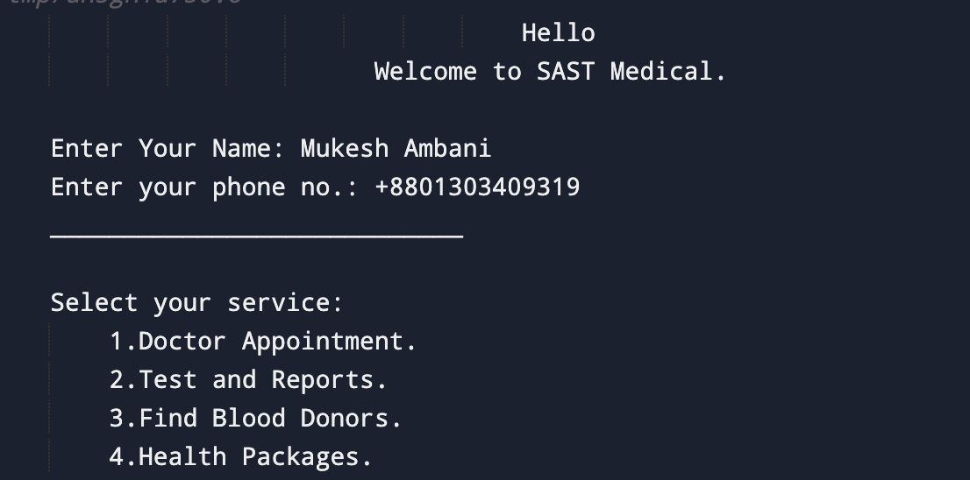
SAST
Medical
Code Breakdown
User Interface

Slide 11

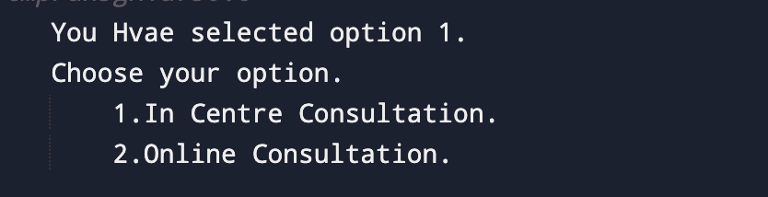
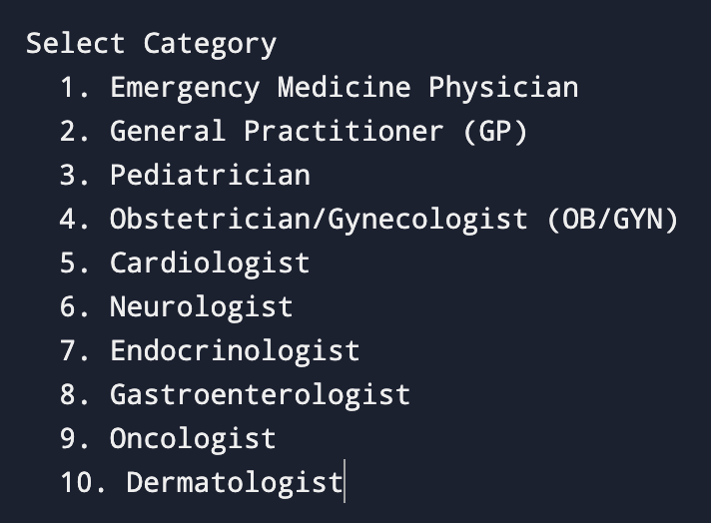
DOCTOR’S APPOINTMENT
SAST
Medical
1. User Prompt: The program prompts the user to enter a category number.
2. Category List: Displays a list of categories with corresponding numbers for the user to choose from.
3. Input Processing: Reads the user's input for the category number using `scanf`.
4. Switch-Case Statement: Utilizes a switch-case statement to handle different cases based on the category number entered.
5. Category Outputs: Prints the corresponding category based on the user's input using printf statements within each case.
6. Default Case: Handles cases where the input doesn't match any of the specified categories by printing "Invalid category number".

Slide 12
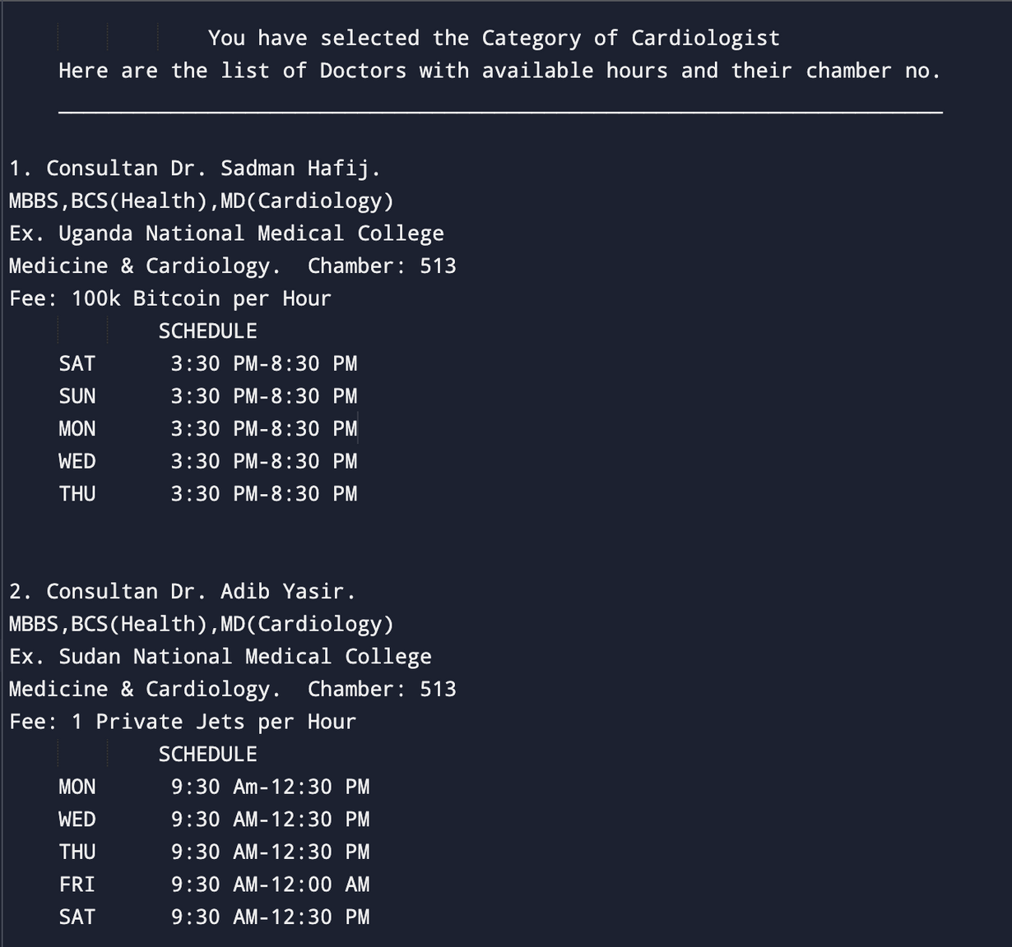
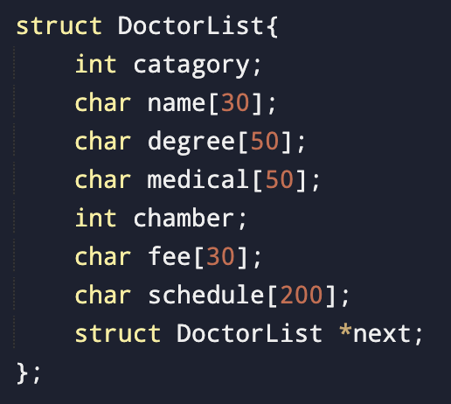
SAST
Medical
DOCTOR’S APPOINTMENT
Structure to make a list of Doctors
We will use stack to store
the data of the doctors
First we will store all the data of our doctors using linked list and stack. So that we can push new data without traversing the whole list.
Then when user input their categories we will match this with the category section of our doctor list by traversing it.
If we found match between the category section of our stack and user input we will print those nodes.
04

Slide 13
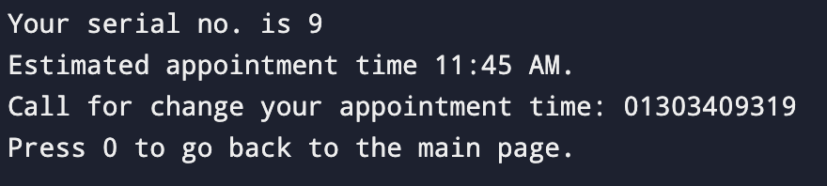
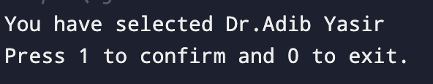
DOCTOR’S APPOINTMENT
SAST
Medical
1. To implement this part of our program we will use Queue instead of Stack because Queue follows FIFO
(First In First Out principle) principle.
2. The patient who confirms appointment first he/she will be served first as per FIFO principle.
Here we will use a variable ’count’ to count the number of patient.
After that we will give an estimated time to the patient to attend the appointment
by multiplying count by 15 and adding it with our starting hours.
If the user press 0 then we will redirect the user to the 1st page of our program.
We added another function after printing the serial to go to the main page.

Slide 14
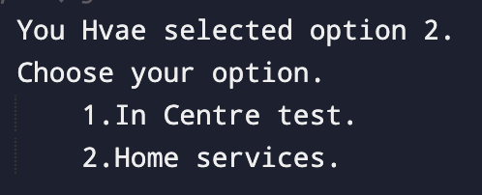
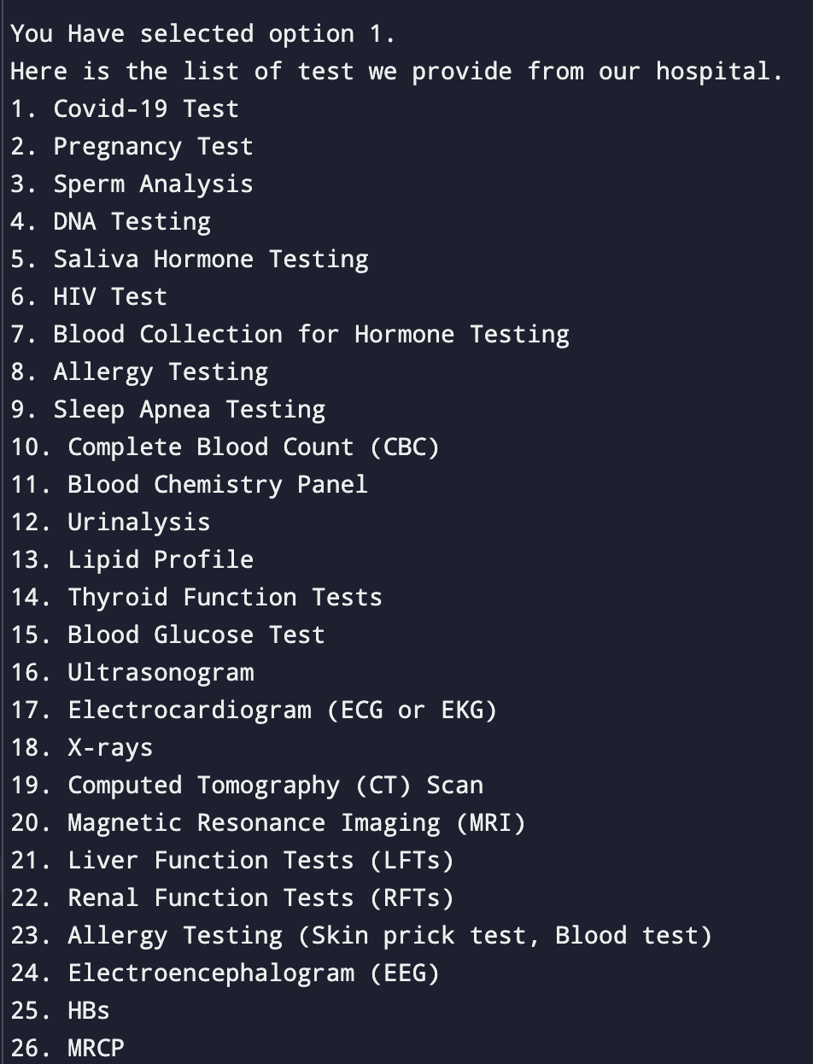
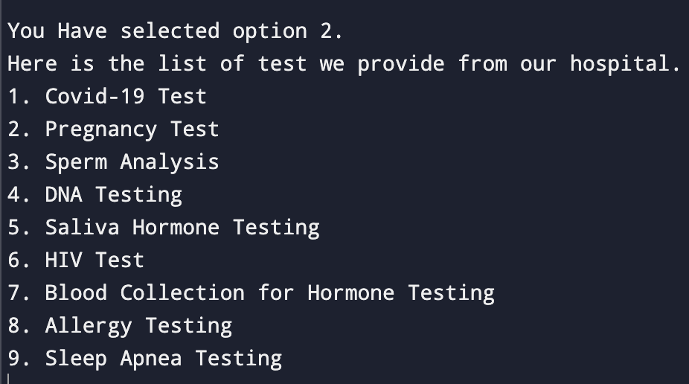

TEST & REPORTS
SAST
Medical
1. Here we can use switch case statement to implement this tase cases.
2. If the inputted number matches any cases then we will print necessary information.
3. Otherwise we can print invalid input and send user to main page.
4. If the inputted value and the cases value matches then it will print the
Information like cost and other details of the test.
OR
We can implement stack here too.
If we don’t know the total number of tests or the testing section is under
progress then we can use here the stack to add the newly introduced tests
to our program.
3. In stack we will use structure to store the related information related the
Tests.

Slide 15
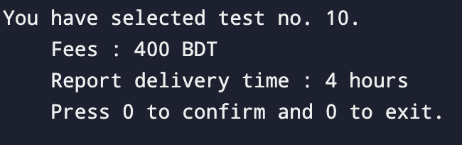
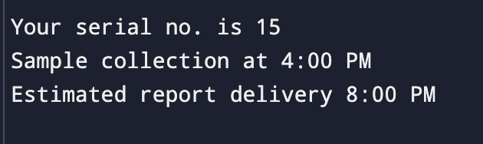

TEST & REPORTS
SAST
Medical
Here we have shown the detailed view of the test with their fees.
Then if the patient press 1 it will confirm the appointment and give a serial no with estimated sample collection and delivery time. And
after that if the user press 0 then it will redirect patient to the home page.
3. And if the patient press 0 it will redirect the user to main page.
For test and reports section we will use Queue to implement the
number of patient.
2. The serial will be given as the first one who booked for appointment
will be served first.
3. As we know that Queue follows the principle FIFO ( First In First Out).
4. The new patient will be added to the rear part of our queue so the
time complexity to add new patient will be O(1).
The person who entered first in the queue will go for the test first
there’s a pointer named front point to the first element of a queue.

Slide 16

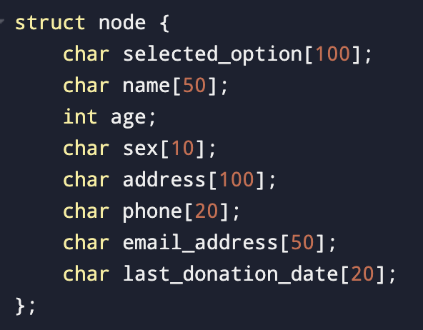
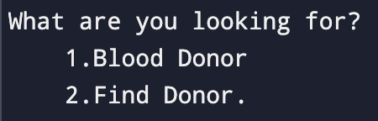
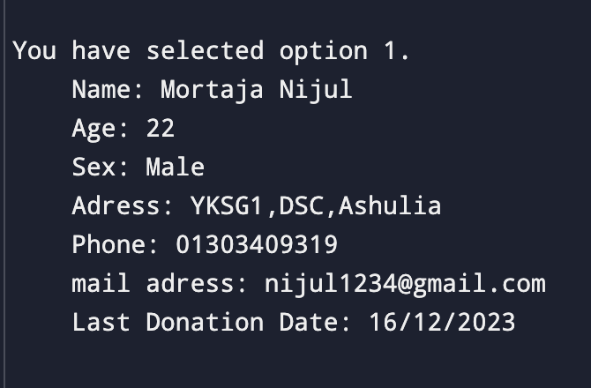
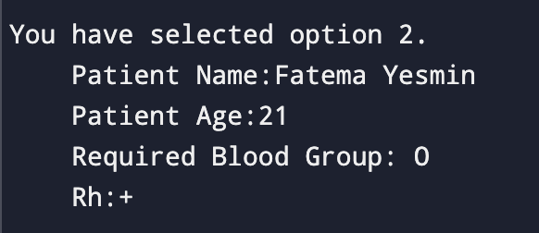
SAST
Medical
BLOOD DONOATION CENTRE
Structure for Donors Details
A linear search operation will be performed at the stack. If the Blood group of the patient and blood group of the user matches we will print the entire node details until we found the NULL part of our stack
1. We will use stack and linked list to store the data of the donors.
Because it is a Dynamic process where number of donors are
Not defined.
2. By using stack to add new donor our program will be able to
Avoid unnecessary traversal from head to the last of the node
For add new members.

Slide 17
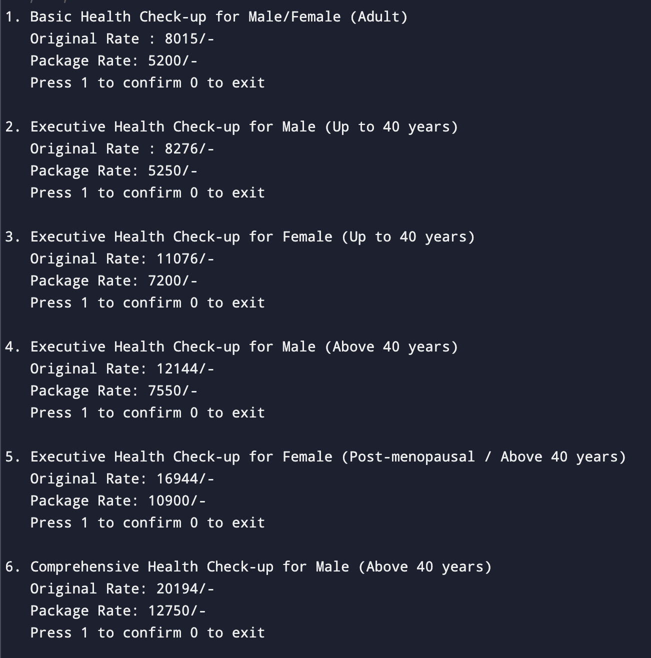
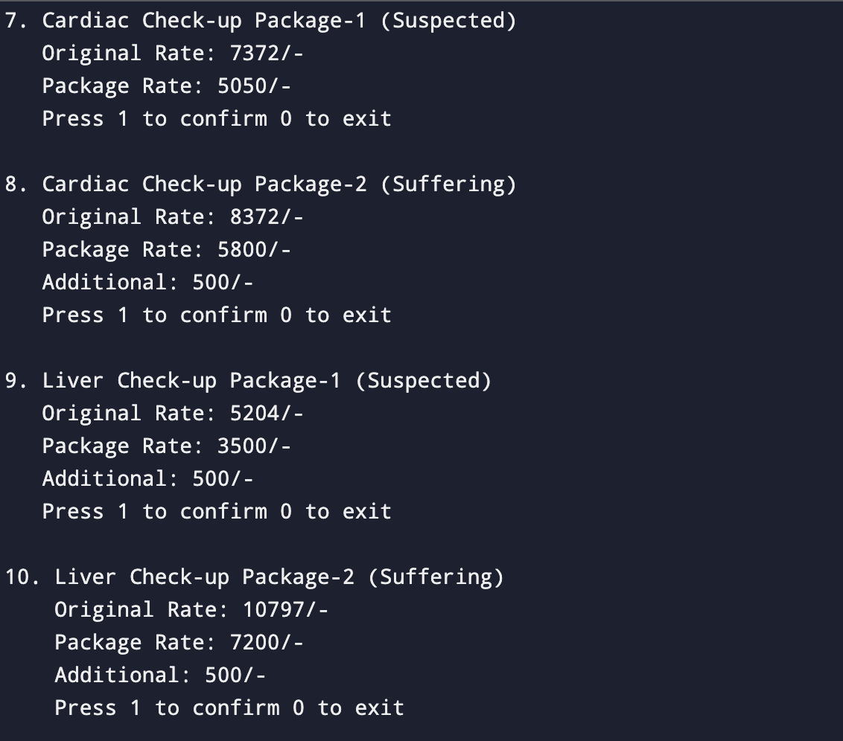
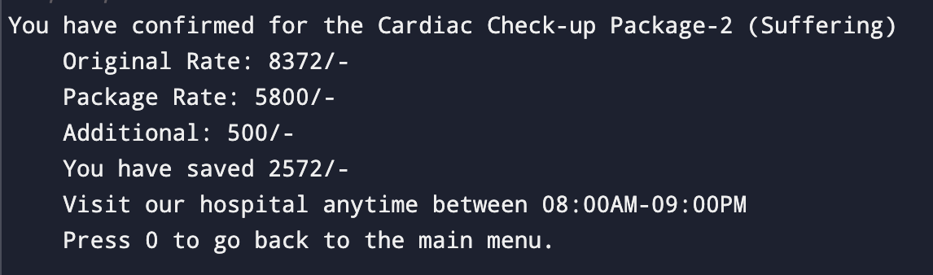
Health Care Packages
SAST
Medical
1. Stack implementation suits our project as it adheres to the Last In, First Out (LIFO) principle.
2. Adding new health check-up packages becomes straightforward without the need to traverse the list.
3. Stack operations offer constant-time complexity, ensuring efficient handling of entries.
4. The LIFO nature of stacks aligns well with the task of managing health check-up packages.

Slide 18

SAST
Medical
EXPECTED OUTCOMES
1. Smooth Operations: Making things run smoothly behind the scenes, so everyone can focus on what matters most – providing care.
2. Happy Patients: Creating a hassle-free experience with easy scheduling and shorter wait times, because nobody likes waiting around!
3. Better Record-Keeping: Keeping track of patient info like a pro, so doctors have all they need at their fingertips.
4. Encouraging Wellness: Cheering on healthy habits and community involvement, because health is about more than just appointments.
5. Healthcare for All: Making sure everyone gets the care they need, wherever they are, because health shouldn't have barriers.
6. Using Resources Wisely: Getting the most out of what we have, so we can do more with less – it's good for everyone!
7. Changing Lives: Creating a world where healthcare is easy, accessible, and centered around you – because everyone deserves to be healthy and happy.

Slide 19

SAST
Medical
Team Collaboration
Effective team collaboration was instrumental in driving the success of our Diagnostic Centre Management System project. Our diverse team, comprising members with varied skills and expertise, synergized efforts to merge technical proficiency with medical insight. Encouraging open communication and distributing responsibilities equitably, we adeptly tackled obstacles and leveraged each team member's strengths to achieve our objectives.

Slide 20

SAST
Medical
Future Directions
1. Expansion into Digital Platforms: We aim to broaden our reach and accessibility by venturing into digital platforms, including the development of web and mobile applications. This expansion will facilitate easier access to our services for a wider audience.
2. Transition from C Language to Python and Beyond: While C language has been our primary tool for development, we're considering transitioning to more versatile and high-level languages like Python. Python's simplicity, readability, and extensive libraries make it an ideal choice for various applications, from data analysis to web development. By embracing Python, we aim to enhance our productivity, streamline development processes, and adapt to modern software engineering practices.
3. Web and Mobile Application Development: Developing web and mobile applications will allow us to offer our services seamlessly across different platforms, catering to the diverse needs of our users. These applications will provide intuitive interfaces, enhanced functionalities, and real-time interactions, enriching the user experience.
5. User-Centric Approach: Our future endeavors will remain cantered around the needs and preferences of our users. We will gather feedback, conduct user research, and iteratively refine our digital solutions to ensure they meet the evolving demands of our audience.

Slide 21

SAST
Medical
CONCLUSION
Our diagnostic center management project in C represents a milestone in healthcare optimization. By integrating doctor's appointments, test management, blood donation, and health packages, we've fostered a streamlined and patient-centric approach to healthcare delivery.
With a focus on efficiency and accessibility, our system empowers users to navigate healthcare processes seamlessly. Moving forward, we are committed to leveraging technology to drive further advancements in healthcare management, ensuring quality care for all.
We extend our gratitude to our team, stakeholders, and users for their invaluable support. Together, we've set the stage for a healthier future.

Slide 22


SAST
Medical
Do Have Any Questions?

Slide 23

SAST
Medical
Thank
You.
For Your Attention

